Slide 1
PhotoPharmics
Brett Brandom
Jacob Dodd
Chris Gargano

Slide 2
Team Ara
Brett Brandom
University of California Irvine, 2018
Master of Science in Physics
Research Associate 2015-2018
Jacob Dodd
University of California, San Diego, 2016
Bachelor of Environmental Systems- Ecology, Behavior and Evolution
Minor in Linguistics
AMN Healthcare
Data Governance Consultant – March 2018 to Present
Liquid Biosciences
Data Engineer – October 2017 to January 2018
San Diego Association of Governments
Transportation Demand Management Intern - November 2016 - October 2017
Chris Gargano
The Pennsylvania State University, 2012
Masters & Bachelor of Applied Statistics
Minor in Economics
Altus Group
Senior Consultant – July 2013 to Present
Marketing Management Analytics
Analyst – July 2012 to June 2013

Slide 3
Client Problem
To understand the sentiment of medical journal articles about a wide variety of diseases and their treatments

Slide 4
The Method Method (M2)
2. Exploratory Data Analysis
5. Analysis / Modeling
1. Get Data
4. Pre-Process Data
7. Present Results
3. Develop Data Science Questions & Plan
6. Evaluate Results

Slide 5
1. Get Data
Data was collected from Pubmed abstracts using a web scraper built in Python
Collected fields include the article title, date, abstract text, keywords, etc.
The user can specify the search terms (diseases, treatments, etc.) and the number of articles to scrape per term
Our group scraped over 30 search terms for 2,000 articles per term (approx. sample size (N) = 60,000)
  Search terms included “parkinsons”, “dementia”, “heart disease”, & “insomnia”
  Web scraping complete in under one minute per search term for 2,000 articles

Slide 6
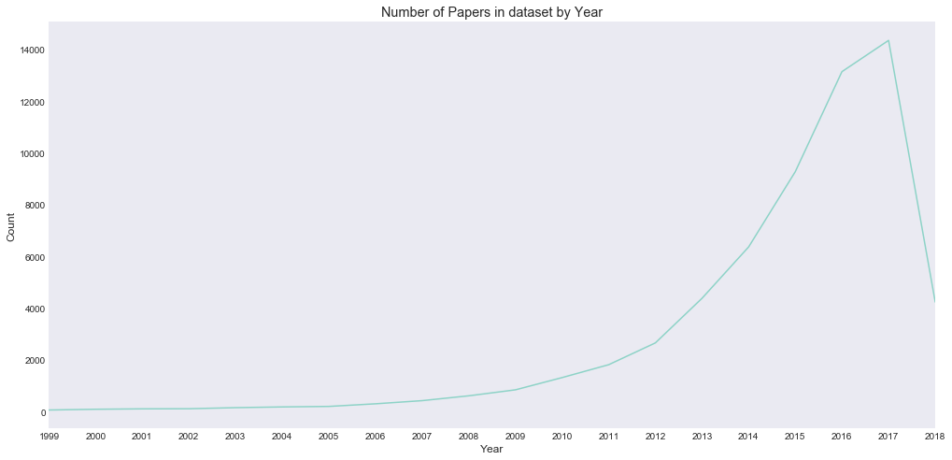
Dataset Composition
Filtered for articles published post 1997
Most published between 2012-present

Slide 7
2. Exploratory Data Analysis
Exploratory Data Analysis (EDA) was performed using R and Python
Article text was broken using the “bag-of-words” approach to text mining
Data was organized into term-document matrices and corpuses to analyze word frequency (both overall and on a per search term basis), number of articles per search term, sentiment, and more

Slide 8
2. Exploratory Data Analysis
The data was analyzed for:
  Most common words by disease
  Word correlation between diseases
  Total and average sentiment by disease
  Average sentiment over time
  TF-IDF (term frequency-inverse document frequency)
  Topic Modeling
  Cluster Analysis (of individual articles, of LDA topics)

Slide 9
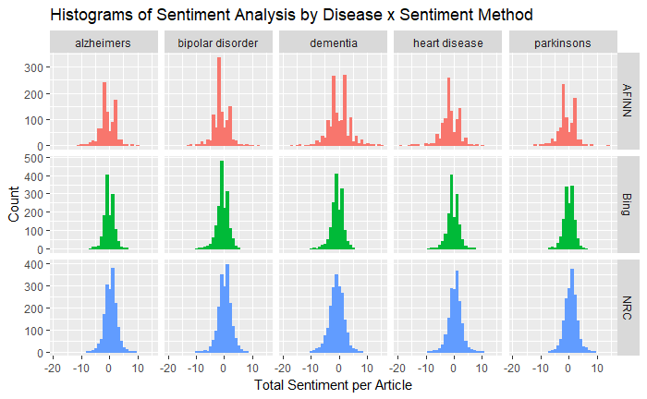
EDA: Different Sentiment Method by Disease
There are several different types of sentiment analysis that can be used on text data
However, most sentiment analysis will provide similar output

Slide 10
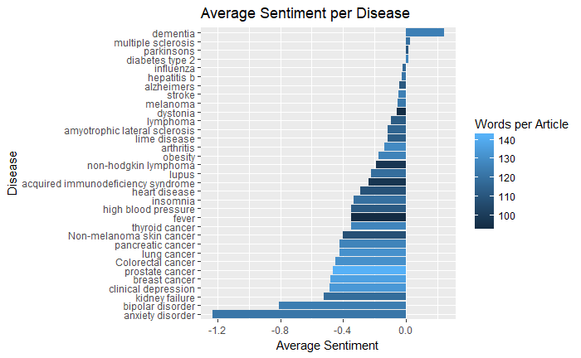
EDA: Sentiment per Disease
Plotting the average sentiment per Disease and average word count visualizes the more polarizing topics
We can see that most topics have a negative average sentiment score

Slide 11
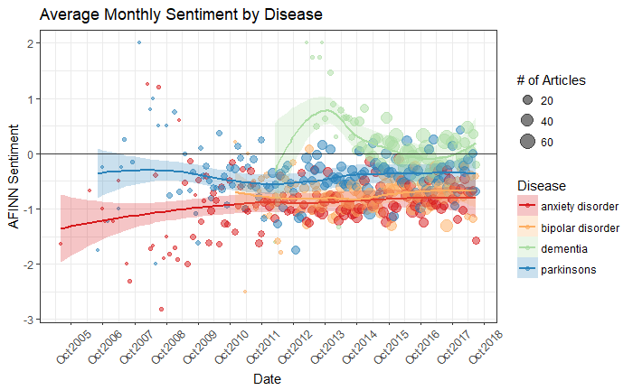
EDA: Sentiment Over Time
Changes in sentiment over time can show whether the medical community’s view on diseases and their treatments has improved, worsened, or stayed mostly the same

Slide 12
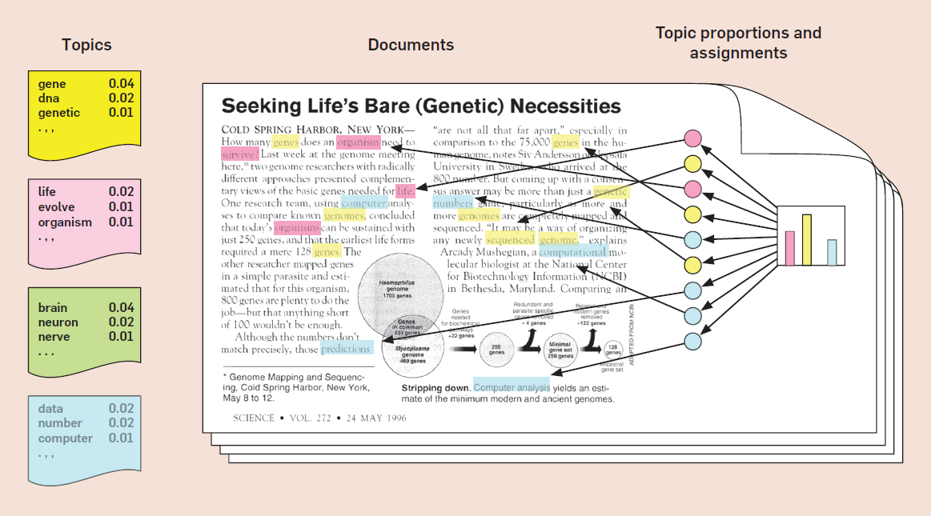
EDA: Topic Modeling
Topic modeling is a statistical method used to determine what topics are present within a collection of documents
It operates under the assumption that documents exhibit multiple topics
Topic modeling determines how much of each topic is represented in a given document
The method we use is Latent Dirichlet Allocation (LDA)
See slide 39 in Appendix for enlarged image

Slide 13
EDA: Validity of Topic Modeling
Does it work? Griffiths and Steyvers (2004) reproduced the PNAS topics codes using LDA, indicating topic models do indeed correlate with scientific disciplines
Working assumption: the topics generated by LDA from a corpus of medical paper abstracts reproduce meaningful fields and subfields of study
Hence, statistical inference on topics yields useful insights into medical research trends

Slide 14
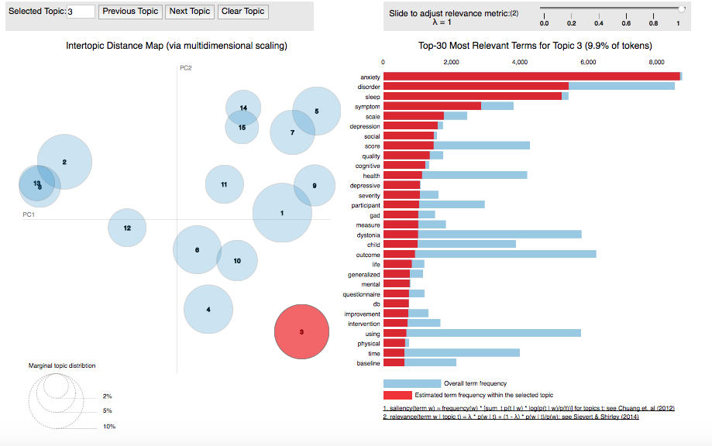
EDA: Visualizing Topics and Word Distributions
Using LDAViz, we can visualize:
  Topic similarity
  Relative importance of topics
  Most salient words per topic
Important tool for assessing quality of the model

Slide 15
Data Science Questions & Plan
Questions
  What is the sentiment around specific diseases / treatments / topics?
  What are the hottest trending diseases / treatments / topics?
  Can we discover patterns and/or relationships among different search terms?
Plan
  Apply bag-of-words sentiment analysis to topics
  Analyze word / disease frequencies and average sentiments among topics to determine which are “hotter” over time
  Use Topic Modeling (Latent Dirichlet Allocation) and K-Means clustering to identify and group articles into “topics”

Slide 16
Data Pre-Processing
Extracted datasets are pre-processed by:
  Cleaning dates
  Removing duplicate articles
  Cleaning article titles
Since the primary focus of the analysis is on the abstract text, those texts specifically are cleaned by:
  Remove stop words (“the”, “a”, “in”, “is”, etc.)
  Stemming (remove suffixes to take the words down to their root)
  Lemmatizing (taking words down to their base form)
After pre-processing, datasets are transformed into term-document matrices and corpuses for text analysis

Slide 17
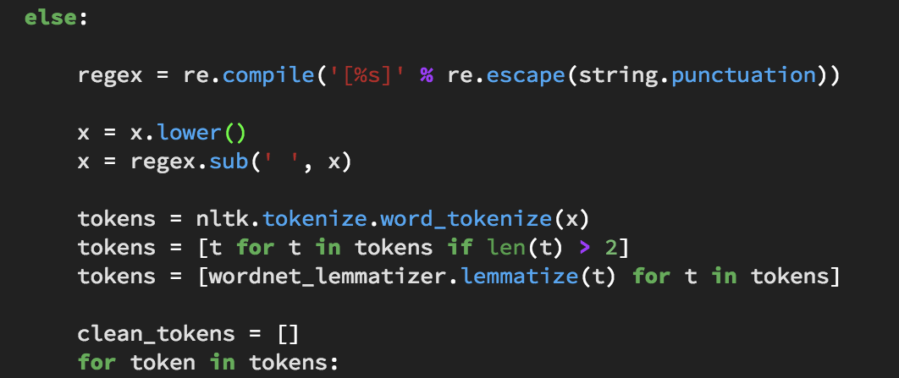
Article Abstract Pre-Processing Workflow
To get into an abstract into a format suitable for analysis, we used the following workflow:
  Tokenization: broke paragraph into sentences, sentences into words
  Removed “stopwords” such as and, or, the
  Removed punctuation and digits
  Lemmatized each word- reduce it to its base, “dictionary” form
    ex: amused —-> amuse

Slide 18
Analysis
Sentiment Analysis is utilized to understand the general level of positivity (or negativity) of an article’s abstract
Latent Dirichlet Allocation (LDA) is a form of topic modeling, and uses statistical modeling to group sets of observations into a specified number of groups / topics

Slide 19
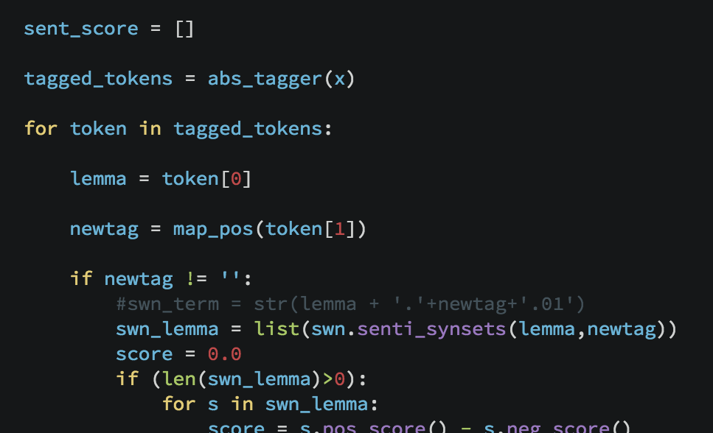
Sentiment Analysis by Disease:
2 Approaches
Percent of Articles with an Overall positive sentiment
  Takes a “consensus” approach - what is the general sentiment in the field?
Average Article Sentiment Score
  Looks at polarity - how positive or negative on average are papers regarding this disease?

Slide 20
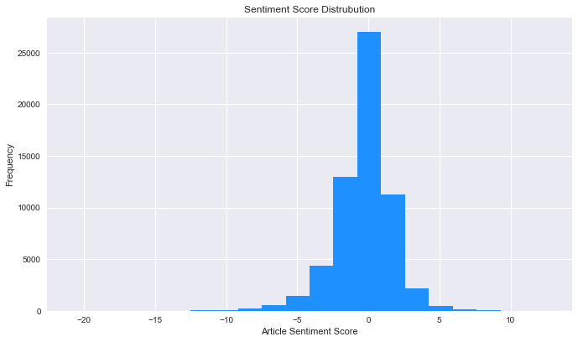
Distribution of Sentiment Scores
Most papers were overall neutral or slightly negative/positive - most likely due to word choice of authors
More papers were negative than positive

Slide 21
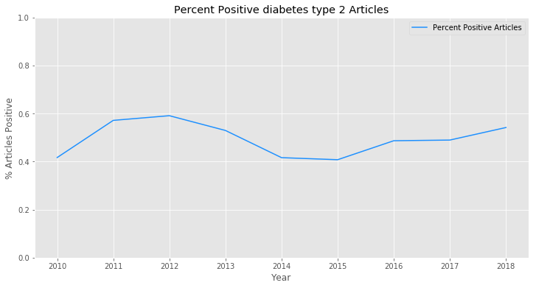
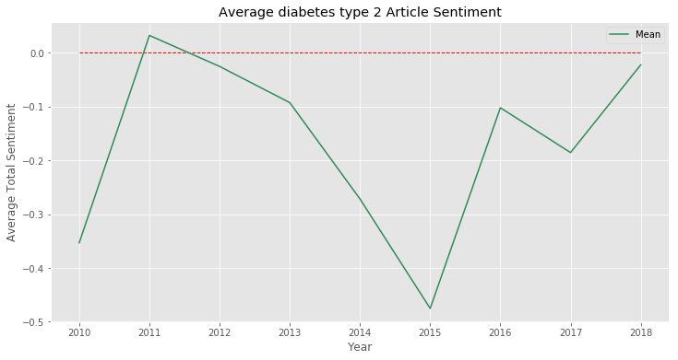
Example: Type 2 Diabetes
Percent of positive Type 2 Diabetes articles has fluctuated between 40% & 60% with slow rise since 2015
Average Article sentiment has risen steadily since 2015 after large drop between 2013 and 2014

Slide 22
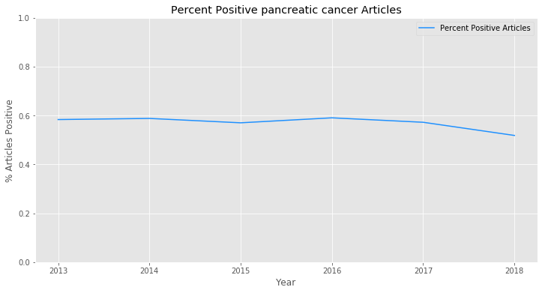
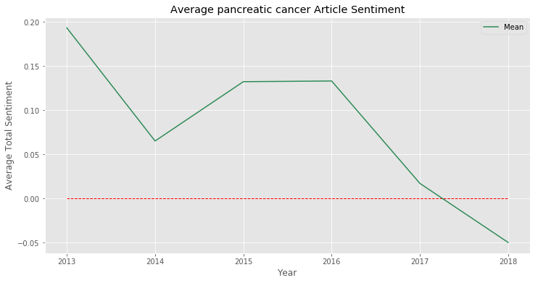
Example: Pancreatic Cancer
Percent of positive articles has fallen from close to 60% pre-2016 to 51% in 2018
Average article sentiment has fallen from being slightly positive all years pre-2016 to slightly negative in 2018

Slide 23
Evaluation of Results
Since the user has the ability to choose a number of search parameters, the evaluation of the resulting sentiment and LDA will be on an ad hoc basis
Sentiment analysis can be viewed overall, or grouped by different diseases / LDA topics
Topics make-up can also be viewed separately in order to understand how diseases become grouped together

Slide 24
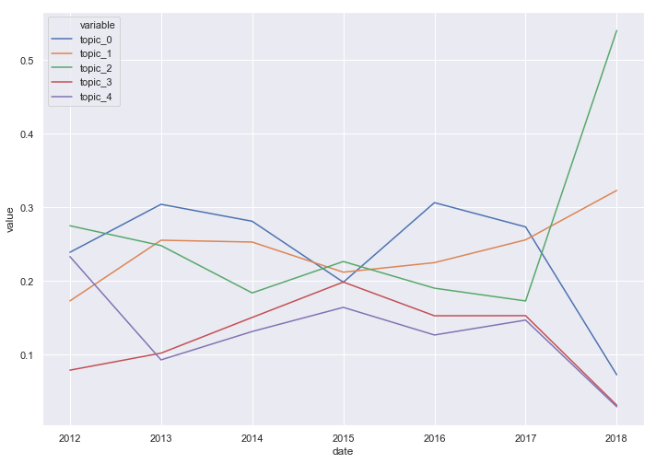
Presentation of Results
Sentiment can be viewed over time on a per disease or per topic basis

Slide 25
Product Prototype
Internal dashboard that allows the user to input search terms, adjust topic modeling parameters, and easily visualize results
User can input a list of diseases to search, specify the number of articles to scrape, a date range, and more
A variety of different sentiment and LDA plots (similar to those generated during the EDA and analysis phases) will be updated in real-time based on the search results

Slide 26
Next Steps / Additional Analysis Ideas
Pending client feedback…
Refine web search and scraping to better fit client needs
Make any requested adjustments to our topic modeling and sentiment analysis
Build Dashboard for internal client use

Slide 27
Questions?

Slide 28
Addenda
Additional Info on:
  Web Scraper
  Exploratory Data Analysis
  Topic Modeling (enlarged image)

Slide 29
Addenda
Additional Info on:
  Web Scraper
  Exploratory Data Analysis
  Topic Modeling (enlarged image)

Slide 30
1. Get Data – Web Scraper Details
Using a web scraping function builtin Python, data was scraped from the online database, Pubmed
The web scraper uses the following parameters:
  terms
    a list or string of objects
    the term(s) to search for on Pubmed
  export_suffix (optional)
    a list or string of objects
    terms that allow the user to specify naming conventions for the output file
  max_articles
    an integer with default 1,000
    the maximum number of articles to return when searching Pubmed
  export
    boolean with default TRUE
    Whether or not the user wants to export the resulting data frame to CSV

Slide 31
1. Get Data – Web Scraper Details
The attributes collected from the scraped articles are:
  ISSN: identifier for the publishing journal
  PMID: Pubmed article ID
  abstract: text of the article’s abstract
  article_title: title of the article
  authors: authors of the paper, separated by a “;”
  date: date published
  disease: from the search_term parameter; the disease being searched for
  journal_title: title of the publishing journal
  keywords: relevant keywords from the article
  language: original language in which the paper was published
  med_type: type of medication / treatment used in the study

Slide 32
Addenda
Additional Info on:
  Web Scraper
  Exploratory Data Analysis
  Topic Modeling (enlarged image)

Slide 33
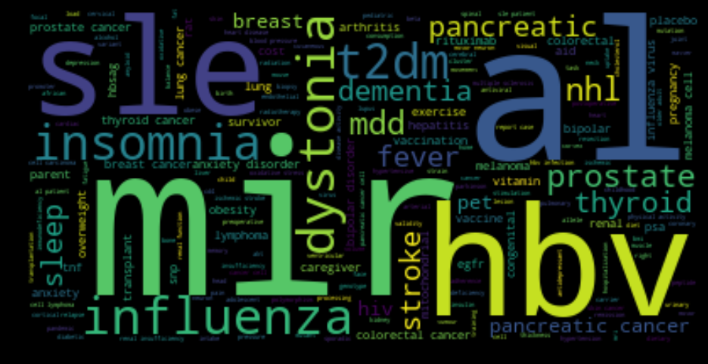
EDA: Word Clouds
Word clouds can be used to easily visualize frequent and important words

Slide 34
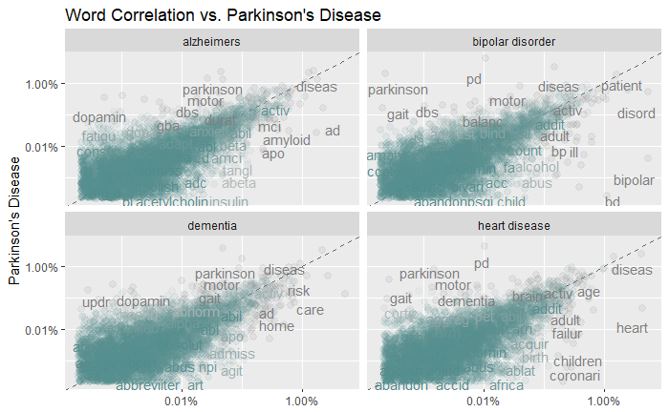
EDA: Word Correlations
Word correlation plots are useful to see which words are more unique to one disease or another

Slide 35
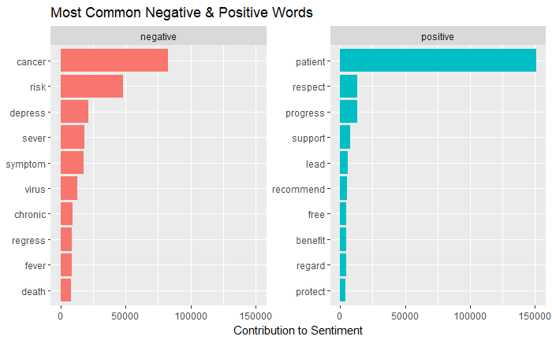
EDA: Word Contribution to Sentiment
Word correlation plots are useful to see which words are more unique across the entire data set

Slide 36
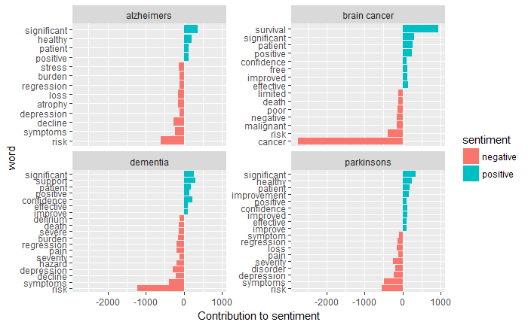
EDA: Word Contribution to Overall Sentiment
Seeing which individual words contribute more towards a search term’s positive or negative sentiment can provide insight into the major topics being discussed in the articles

Slide 37
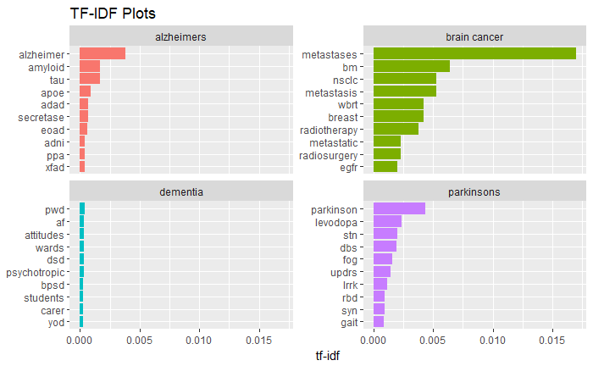
EDA: TF-IDF (Term Frequency-Inverse Document Frequency)
TF-IDF is a measure of the frequency of a word adjusted for how rarely it is used in a document (or in our case, an abstract)
A higher TF-IDF indicates that the word is more important to abstracts relating to its specific disease

Slide 38
Addenda
Additional Info on:
  Web Scraper
  Exploratory Data Analysis
  Topic Modeling (enlarged image)

Slide 39
Topic Modeling

